Slide 1



Students&Companies
R&DD presentation
Irene Lo Presti and Matteo Lussana

Slide 2
User Interfaces

Slide 3
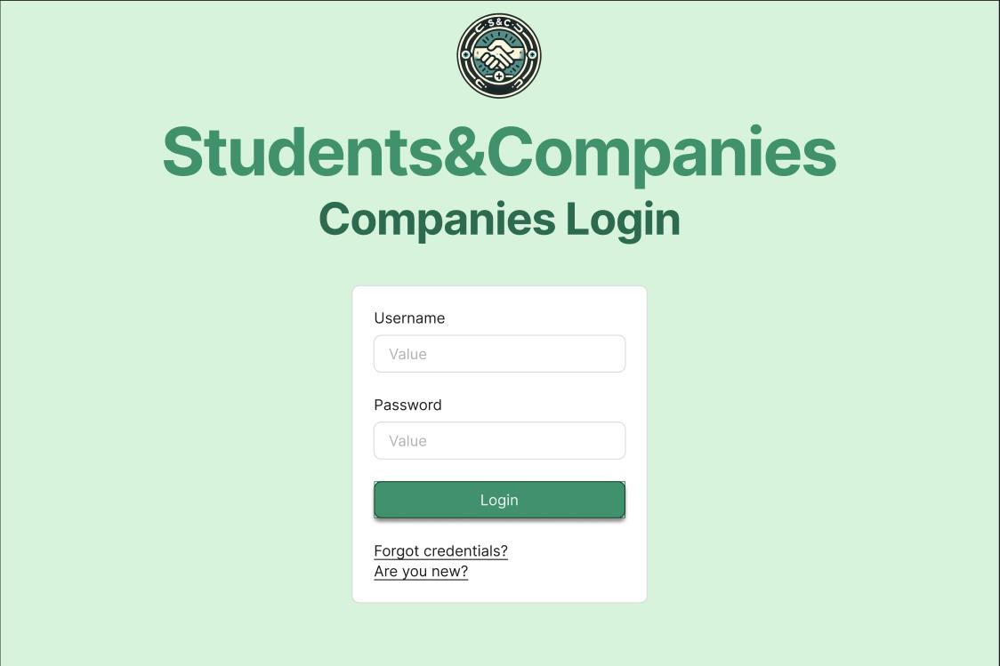

Slide 4
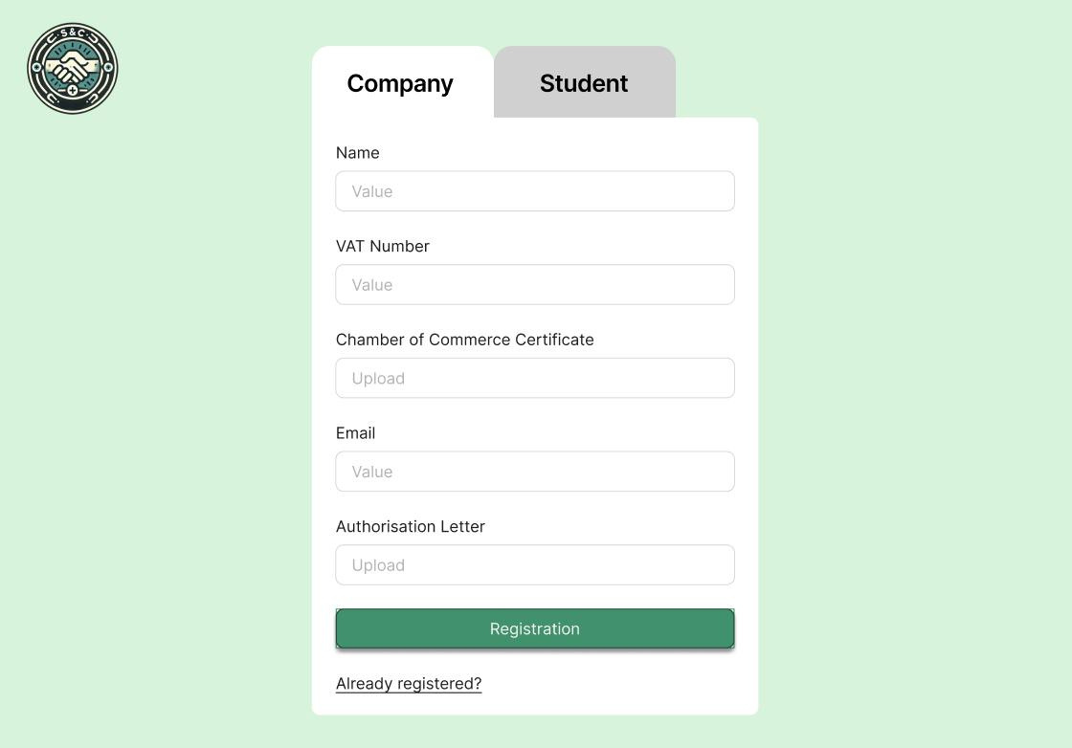

Slide 5
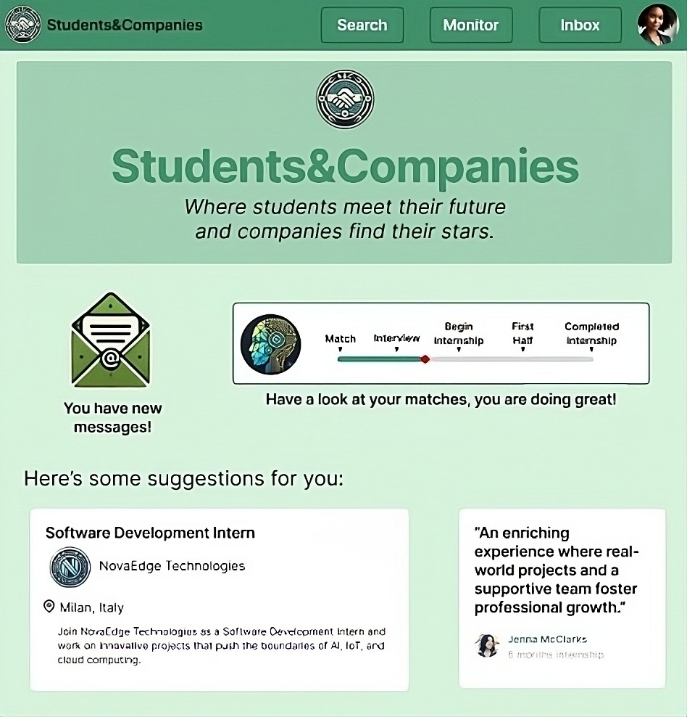

Slide 7
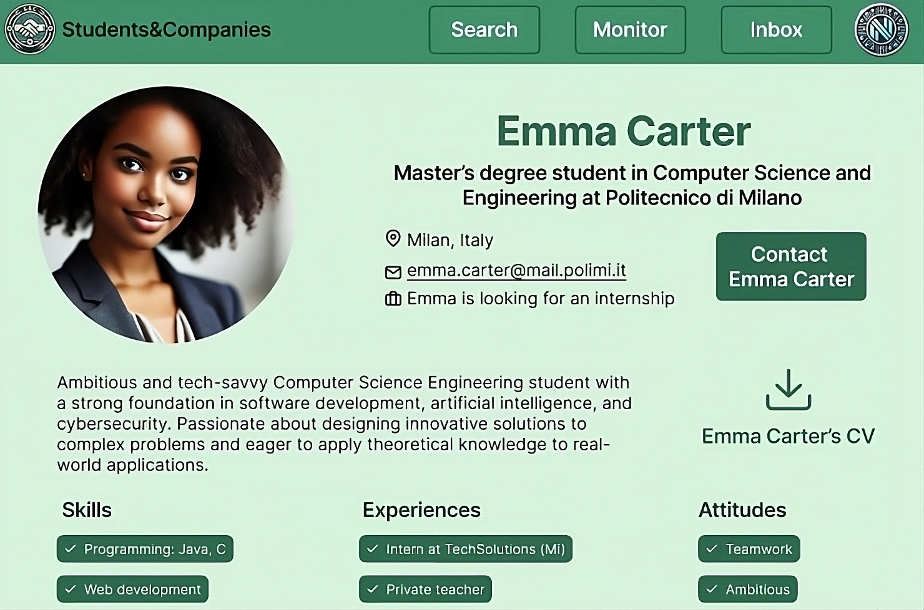
Notes:
Company’s ADVs Page

Slide 8
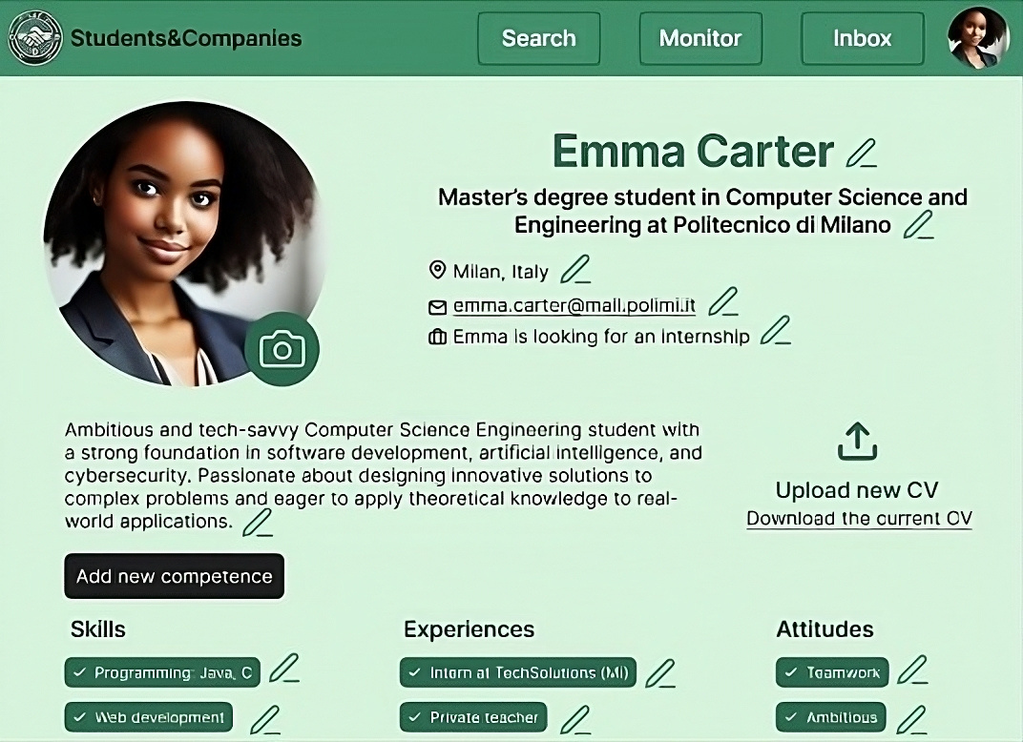
Notes:
Company’s ADVs Page

Slide 9
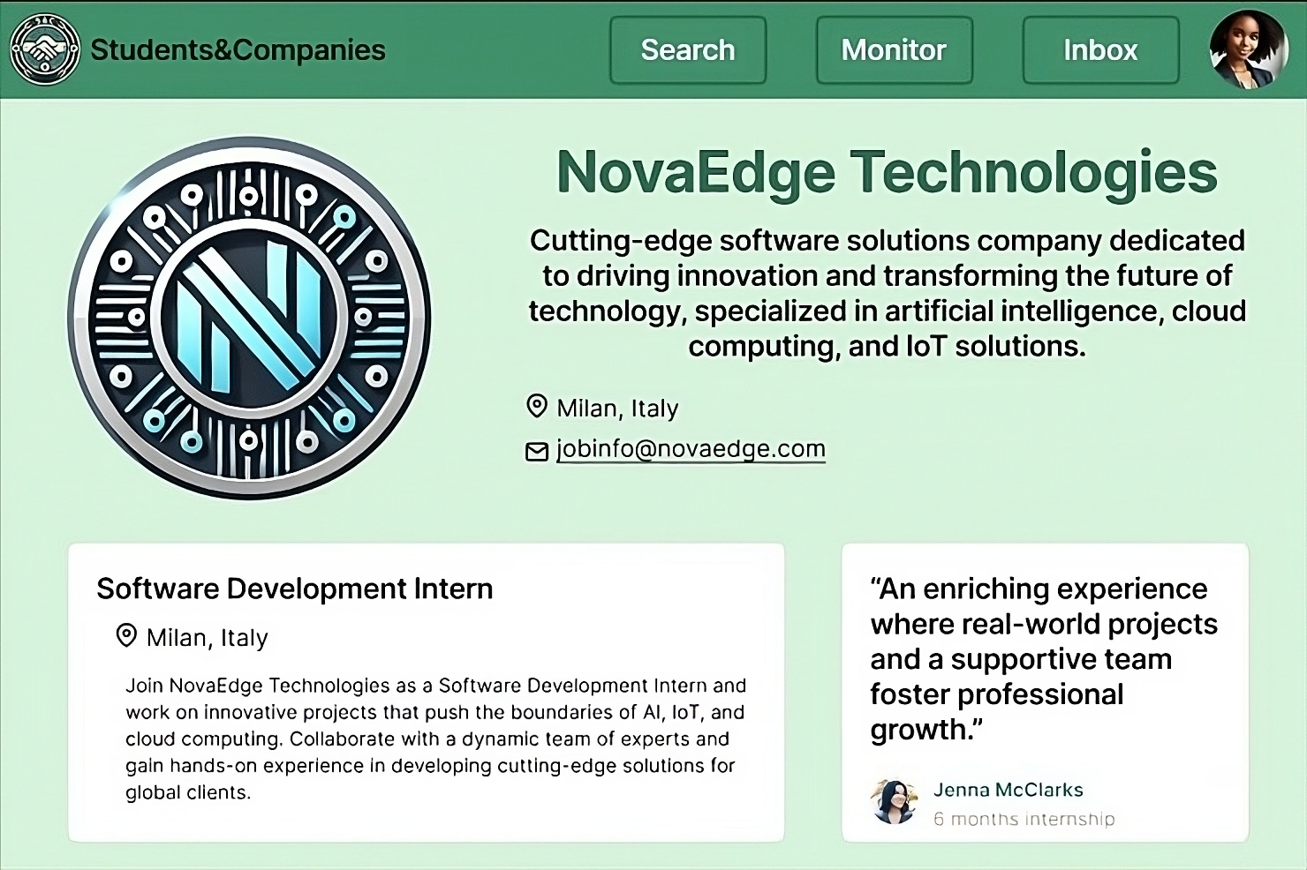
Notes:
Company’s ADVs Page

Slide 10
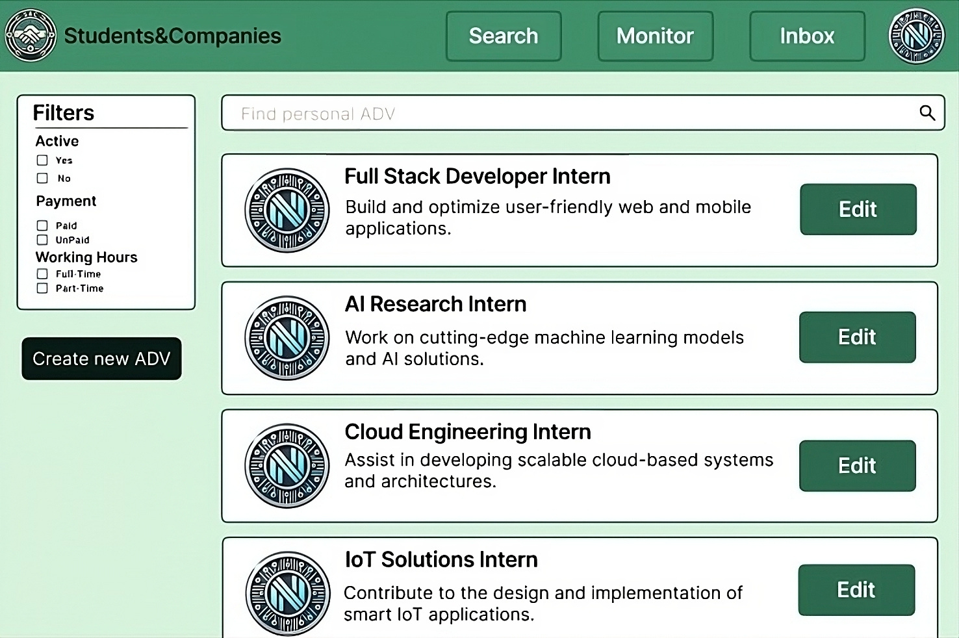
Notes:
Company’s ADVs Page

Slide 11
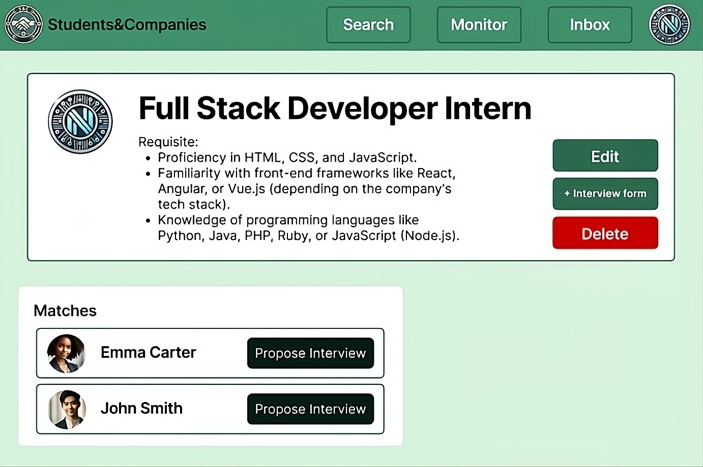
Notes:
Company’s ADV Page

Slide 12
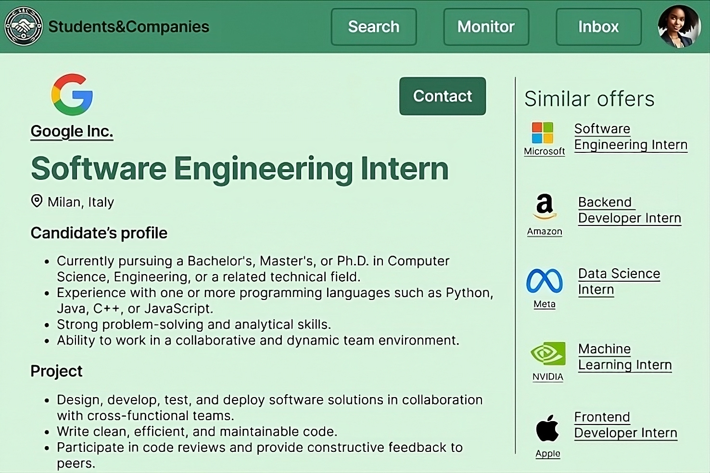
Notes:
ADV Page

Slide 13
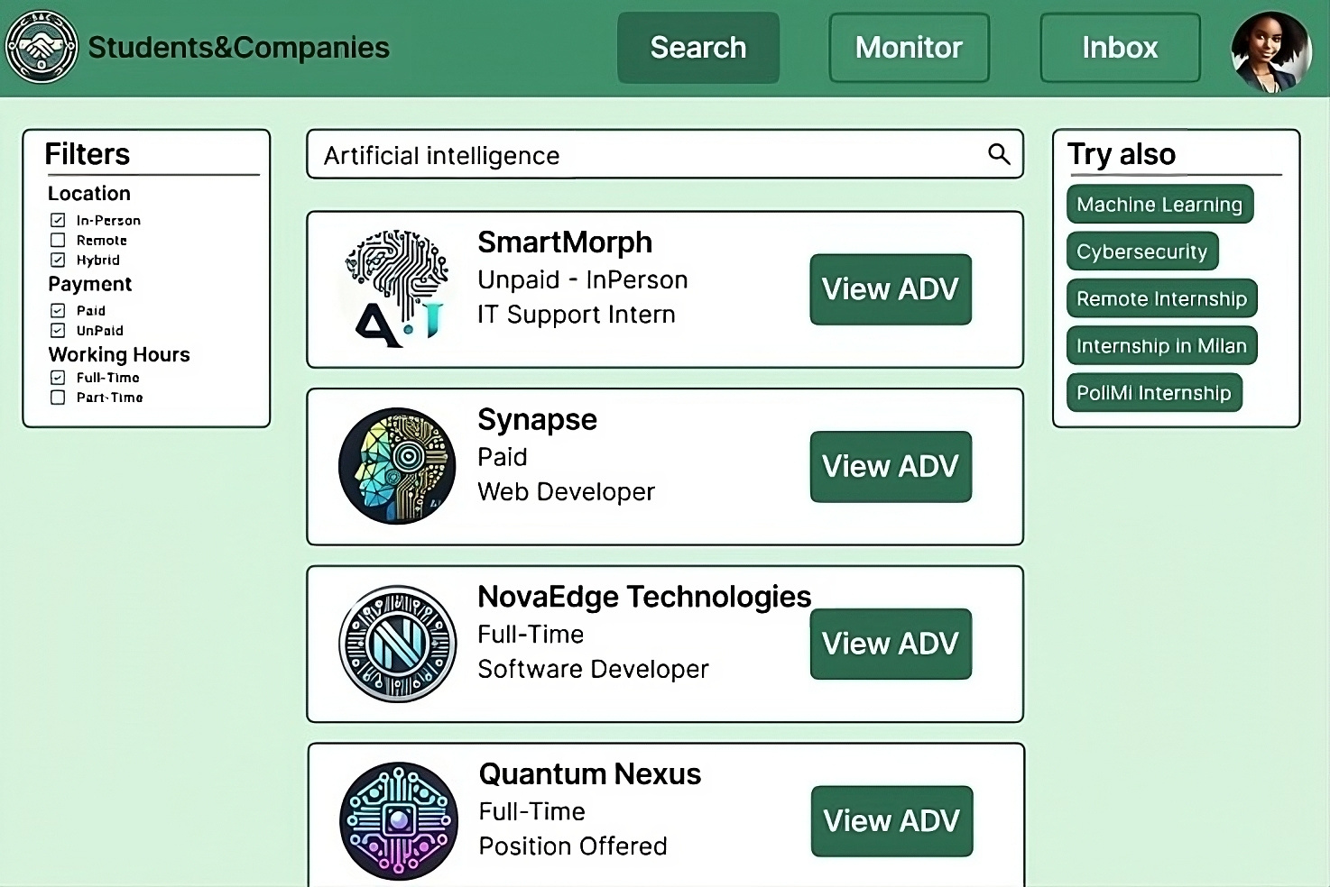

Slide 14
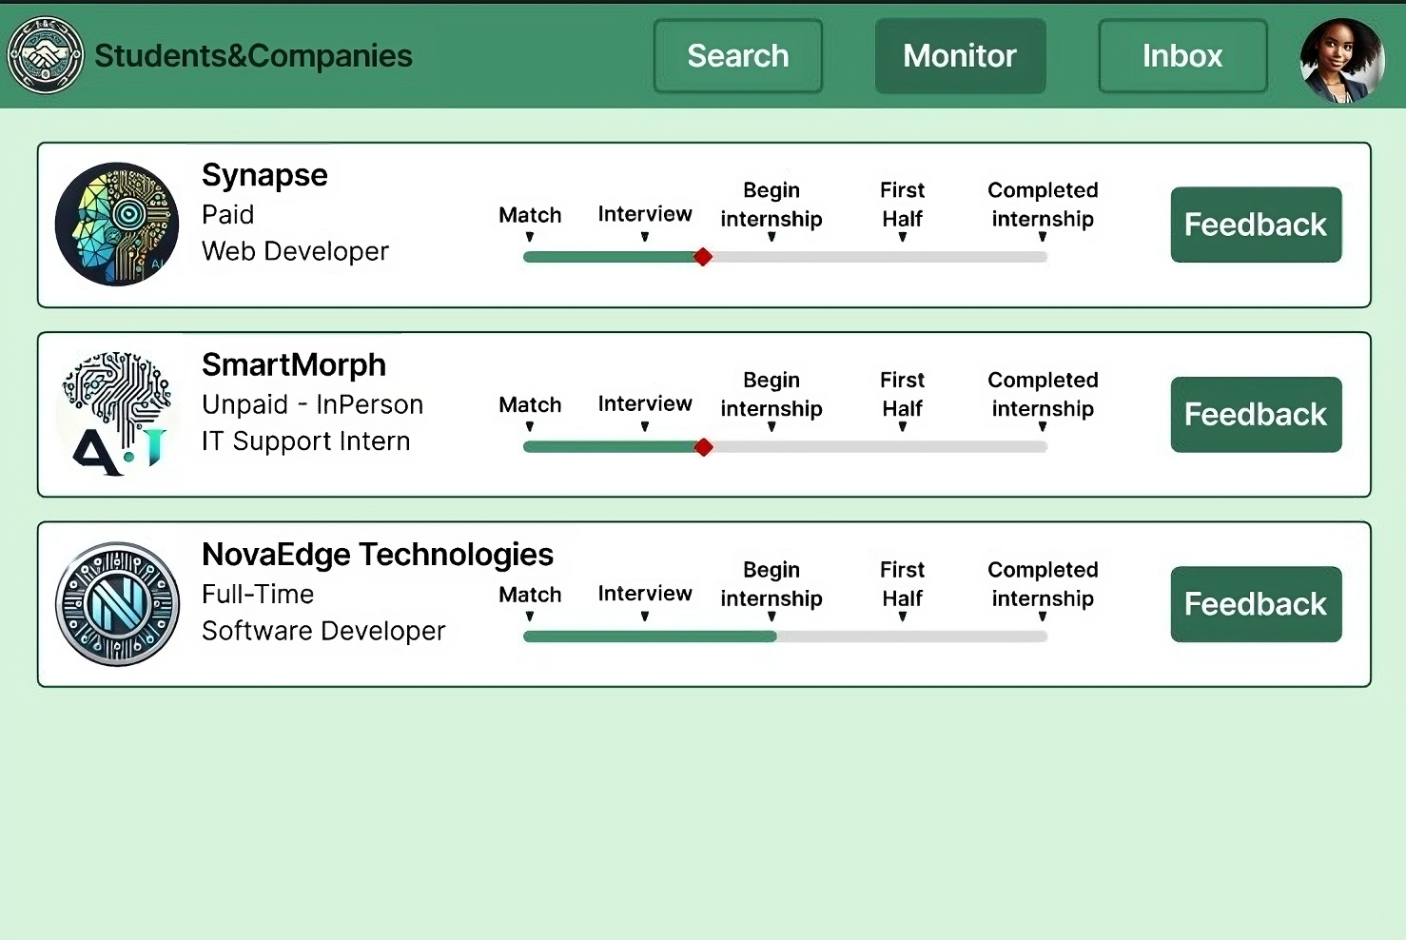

Slide 15
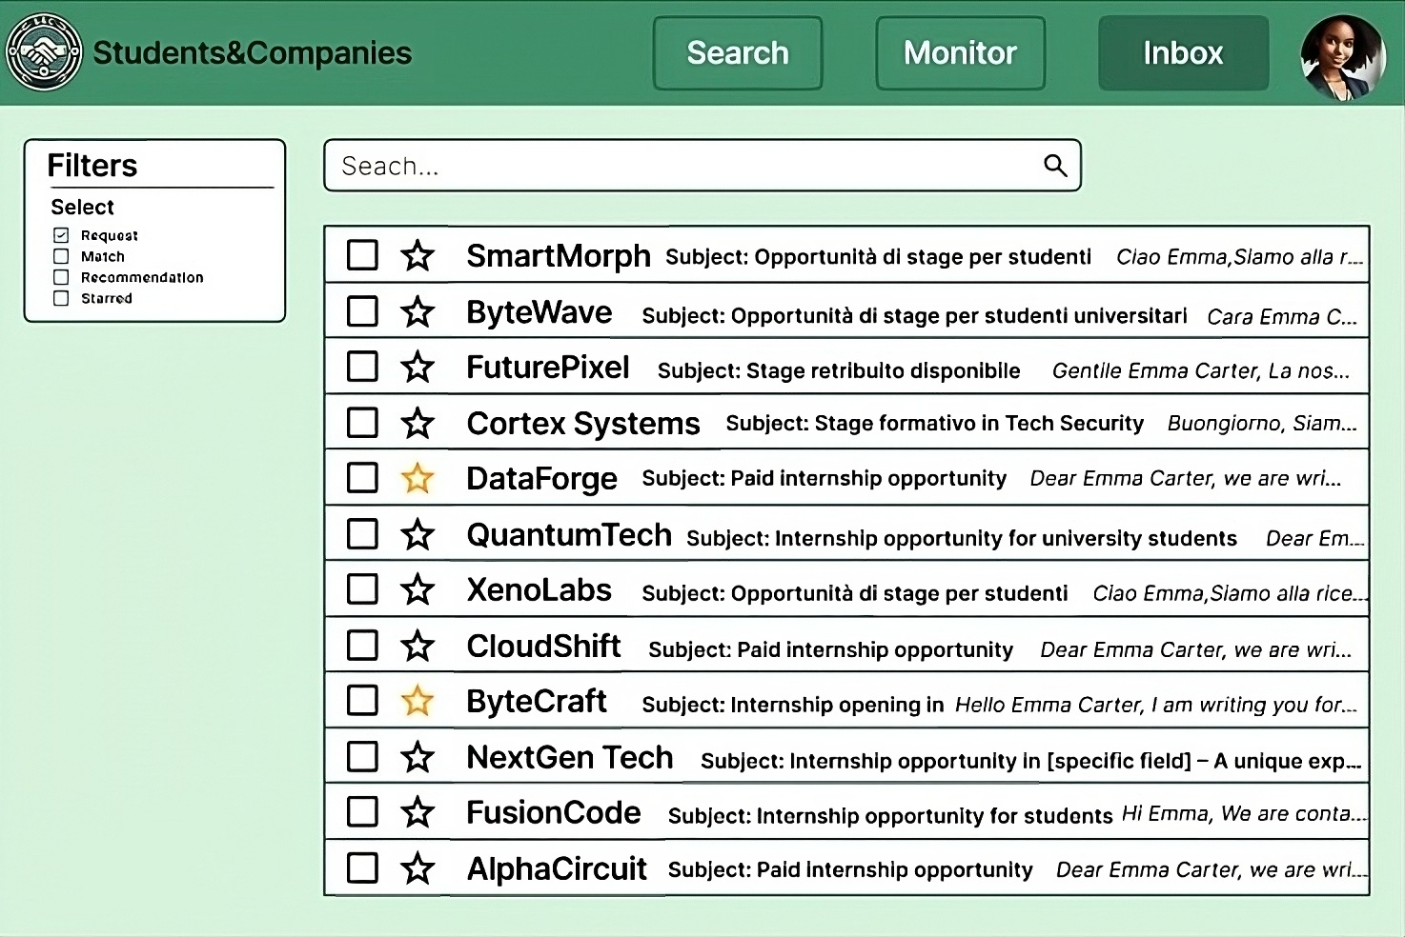
Notes:
<- biglia

Slide 16
Requirements Analysis and Specification Document

Slide 17


01
What are the goals of the system and its scope?
Notes:
biglia->

Slide 18
Goals
G1 - Students
University students can find companies aligned with their interests, apply for internships, complete interviews, and track every stage of the process, from application to the successful completion of the internship.
G2 - Companies
Companies can advertise their internship opportunities to find suitable students for the position, contact them, conduct interviews, hire the best candidates, and keep track of the entire process.

Slide 19
Scope
Outside the system
Inside the system
CV creation and job descriptions occur independently.
Interviews and job performance happen outside the system.
Profile management, internship searches, and recommendation processes are within system boundaries
The system controls notifications and tracking .
Notes:
This distinction highlights the boundary: the S&C platform facilitates and monitors the interaction between students and companies, but it does not control real-world employment decisions or actions.

Slide 20
02
What are the main use cases?

Slide 21





Main use cases
Companies create Internship Adv
Users use
search bar
Students and Companies Match
Students and Companies leave Feedback
Students and Companies Monitor the matchmaking
Notes:
<- biglia

Slide 22
03
What are
the most important requirements and assumptions?

Slide 23
Top-Three Requirements
Companies can advertise their Internship positions
Students and Companies can Match
Students and Companies can Monitor the matchmaking
Companies can explain the internship’s project and the terms offered, ensuing students can evaluate opportunities effectively, leading to more efficient matching.
Students and Companies can find each other through a Proactive Research or by consulting a System Recommendation. They can contact each other and establish a match.
Students and Companies can consult their Match status through the entire process: from the Request to the Internship completion.

Slide 24
Top-Three Assumptions
Real internship positions
Students write the CV honestly
S&C employees are capable
Companies offer real internships, and are honest in listing the projects and the term offered.
Students write their own CV according to their real experiences, skills, and attitudes, in order to facilitate the match making process for both parties.
Employees of the S&C platform that checks the validity of a Company are capable and honest to ensure that registered Companies are real.
Notes:
<- biglia

Slide 25
04
Alloy model purpose
Notes:
mathieu->

Slide 26
Matchmaking consistency
Reachability of matchmaking states
Validity of system constraints
States order respected

Slide 27
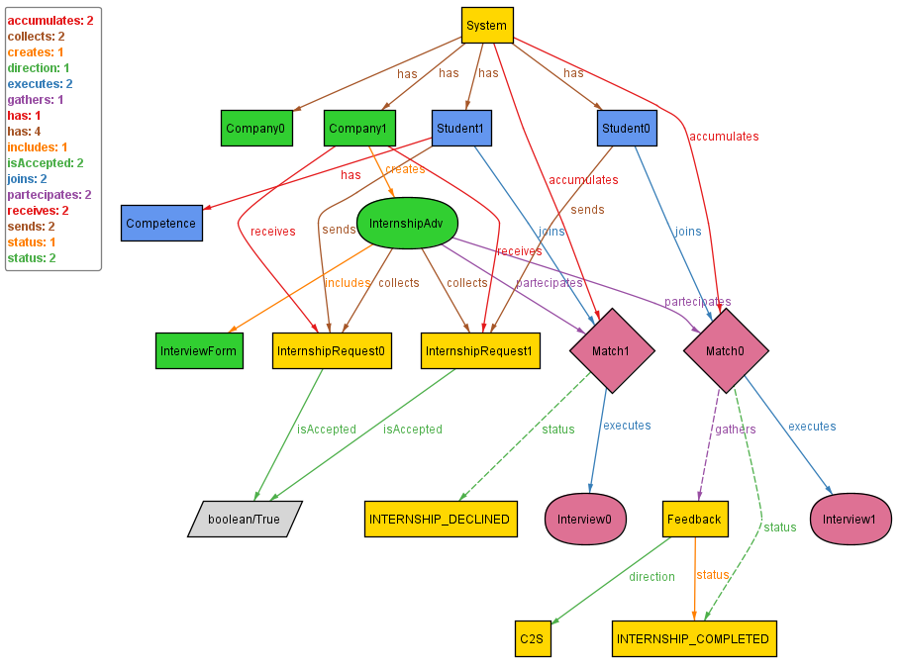
Validity of system constraints
Uniqueness of entities:
e.g. an Internship Adv cannot be owned by two different companies.
Direction of internship requests, recommendations, and matches:
they can be made only between a student and an ADV.
Internship requests and recommendations consistency:
the ADV that collects the internship request has to be own by the company that receives/sends the request.
Interview Form existence:
when a Interview is reached, the Interview Form must be created.

Slide 28
Matchmaking consistency
Reachability of matchmaking states
Validity of system constraints
States order respected

Slide 29

States order respected
INTERNSHIP ACCEPTED
CONTACT CREATATED
INTERVIEW COMPLETED
INTERNSHIP FIRST HALF
INTERNSHIP COMPLETED
INTERVIEW SET
INTERNSHIP DECLINED

Slide 30
Matchmaking consistency
Reachability of matchmaking states
Validity of system constraints
States order respected

Slide 31
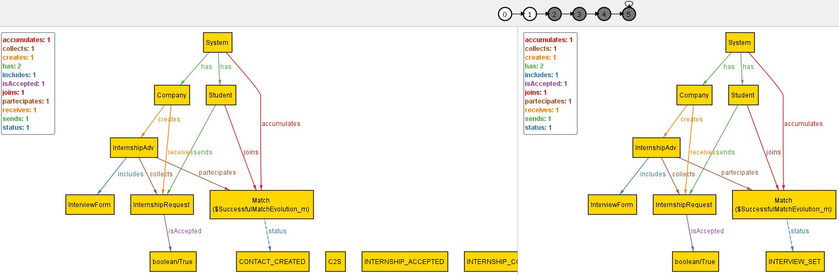
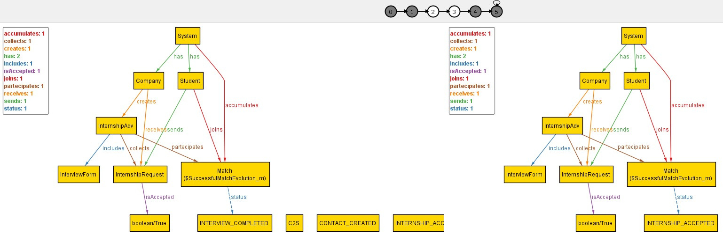
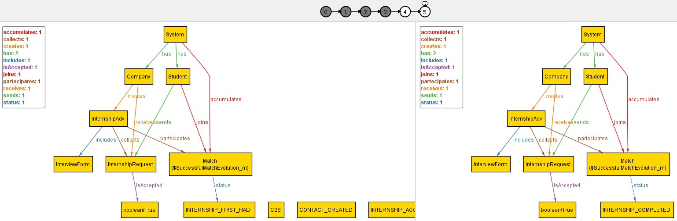
Reachability of matchmaking states
1
2
3
4
5
6
Successful interview

Slide 32
Reachability of matchmaking states
1
2
Successful interview

Slide 33
Reachability of matchmaking states
3
4
Successful interview

Slide 34
Reachability of matchmaking states
5
6
Successful interview

Slide 35
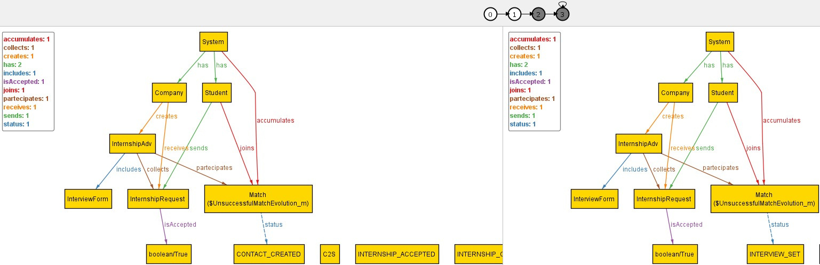
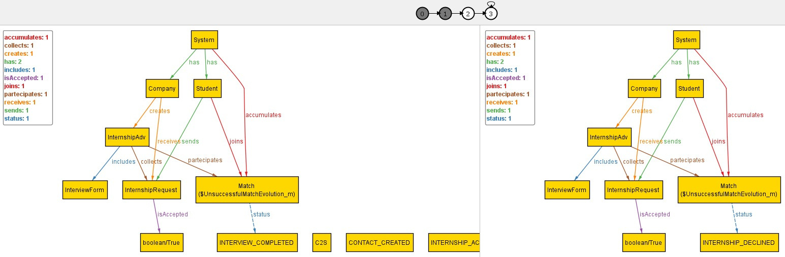
Reachability of matchmaking states
1
2
3
4
Unsuccessful interview

Slide 36
Reachability of matchmaking states
1
2
Unsuccessful interview

Slide 37
Reachability of matchmaking states
3
4
Unsuccessful interview
Notes:
<- mathieu

Slide 38
Design Document
Notes:
technical analysis for development team

Slide 39
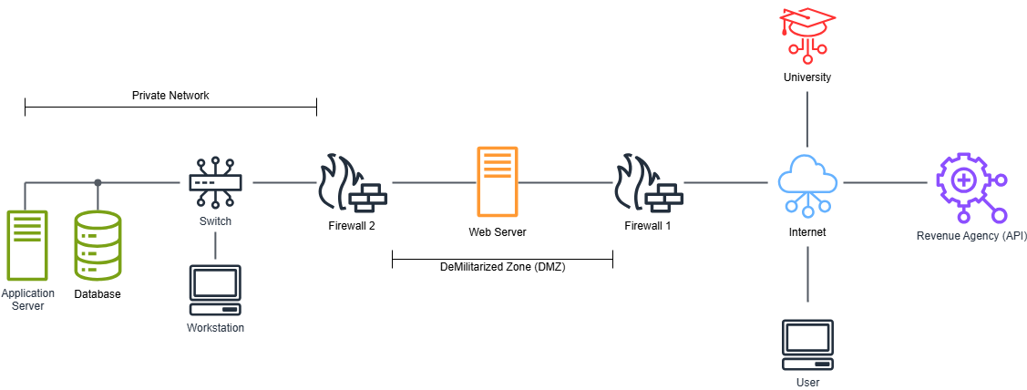
Overview of S&C System
Notes:
platform entire architecture: standard.
private network = backbone with sensitive data and logic
DMZ contains web server accessible by the users

Slide 40
01
What are the components of the system and their interfaces?
Notes:
mathieu->

Slide 41
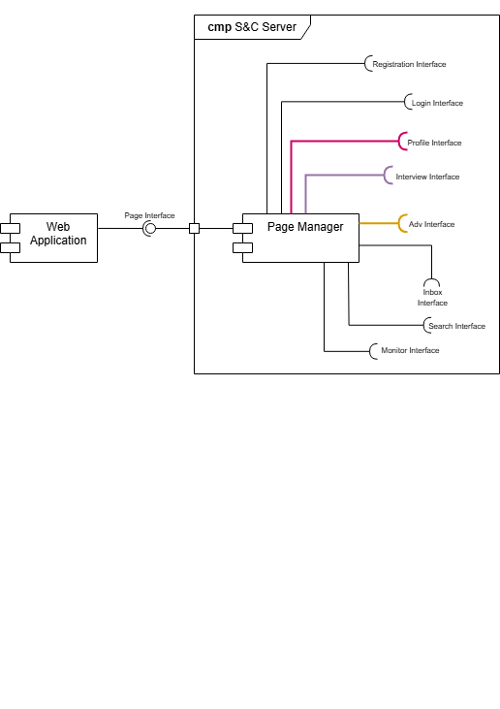
Page Manager

Slide 42
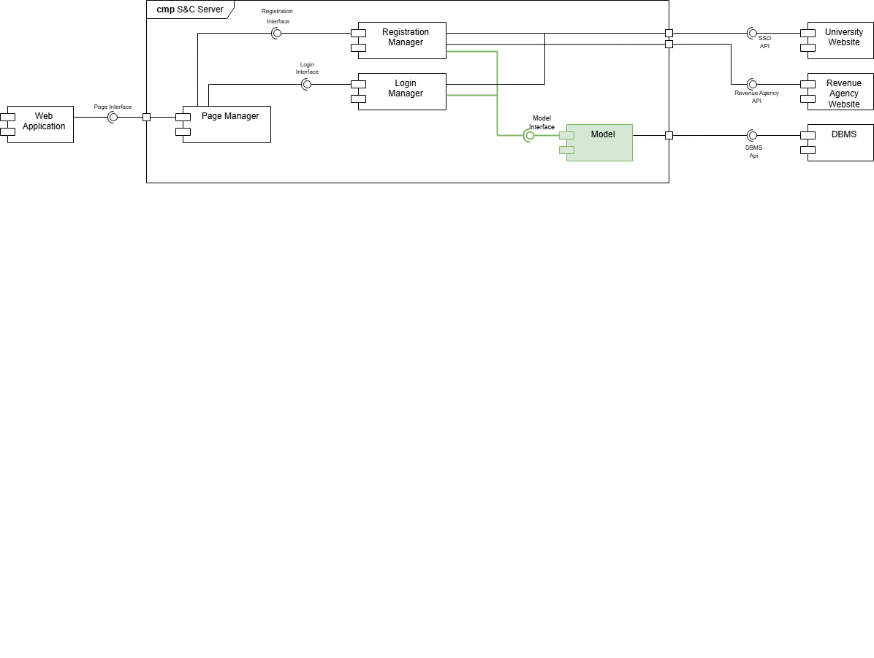
Registration and Login Management

Slide 43
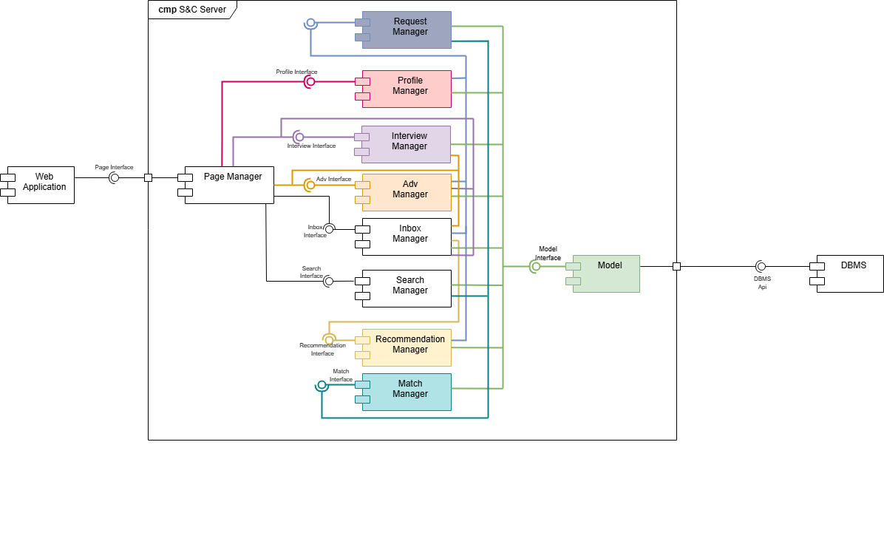
Matchmaking Management
Notes:
1 search + recom
2 profile + adv
3 req
4 inbox
5 match

Slide 44
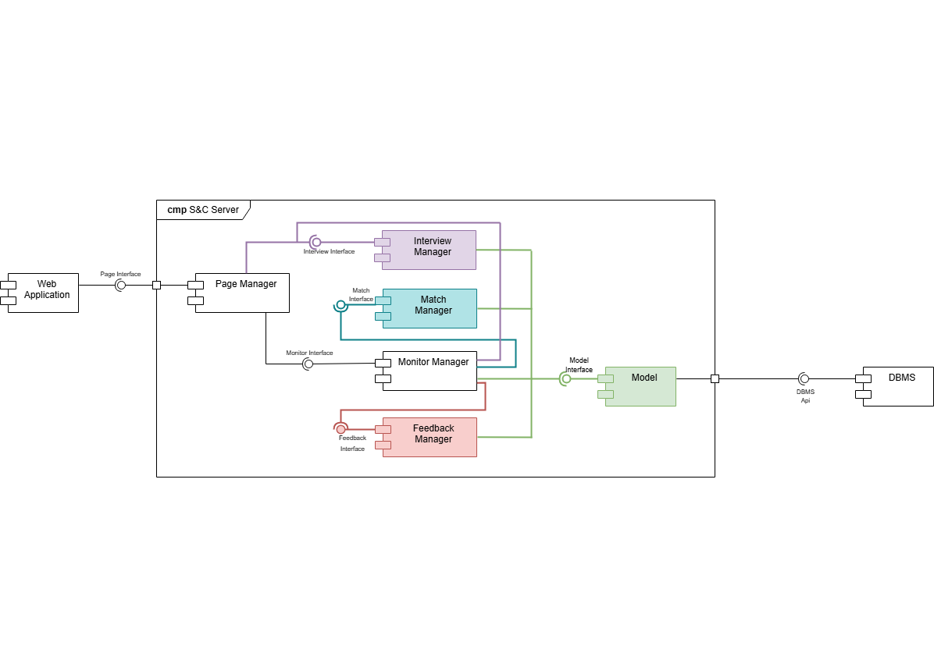
Matches monitoring and feedback
Notes:
<-mathieu

Slide 45
02
Architectural Styles and Patterns
Notes:
biglia ->

Slide 46




Gateway
API
Micro-Service Architecture
Notes:
The Micro-service Architecture divides the application into independent service, each one responsible for a specific functionality. It enables efficient development, testing, deployment, and scaling thanks to its modularity, each micro-service operates independently, communicating with other through APIs. A unified API Gateway serves as a centralised entry point for client requests, reducing direct interactions between clients and individual micro-services.

Slide 47


3-Tier Architecture
Presentation Tier
Application Tier
Data Tier
or User interface Layer. This tier displays information to users
and collects their input. It is represented by the web pages.
or business logic layer. This tier contains the function to process
input, execute decisions, and perform computations. It works as a bridge and is represented through the Model
This tier stores and manages data through databases

Slide 48
Client-Server Architecture
Client
Server
The client is the web browser, it sends requests to the server using HTTPS protocol. The Application Tier processes the client’s requests.
The server processes the client’s requests and provides responses. The Presentation Tier formats the server’s responses
Notes:
<- biglia

Slide 49
03
Implementation, Integration and Testing
Notes:
mathieu

Slide 50

Implementation Plan:
Bottom-Up strategy
This approach consists in develop and evaluate the components individually, and then integrate them into a larger system.
This strategy will allow developers to keep tracks of eventual bugs or errors, and furthermore will allow a parallel developing workflow.
Notes:
mathieu

Slide 51
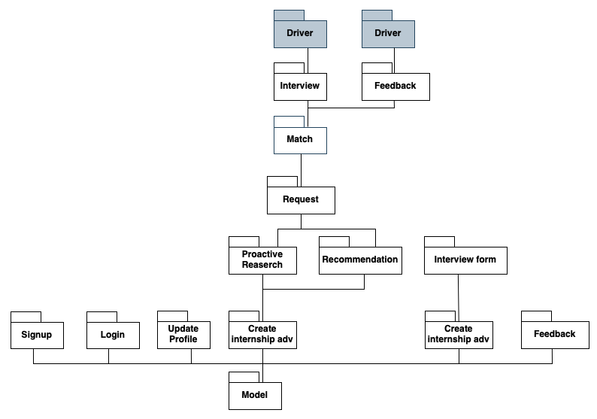
Integration Strategy
Notes:
mathieu

Slide 52
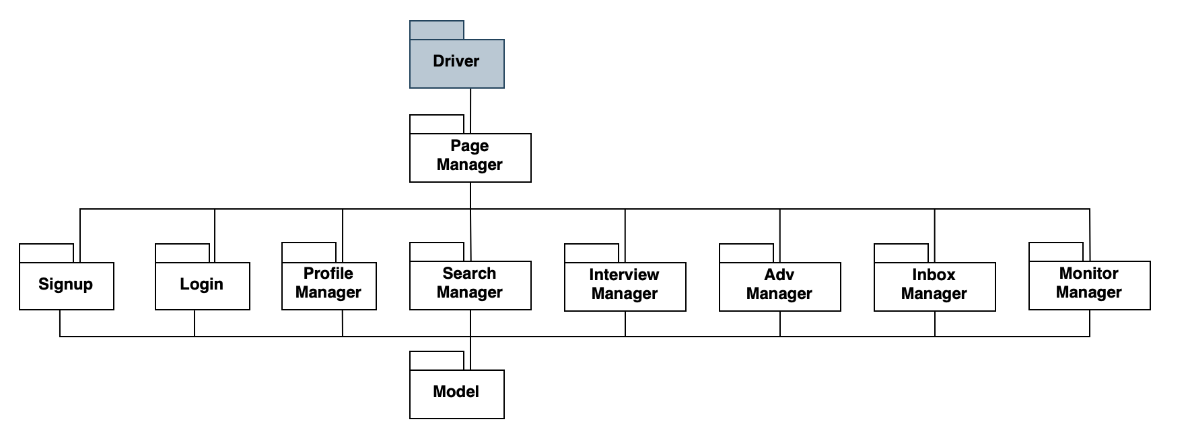
Integration Strategy
Notes:
mathieu

Slide 53
System Testing Strategy
Functional Test
Performance Test
Load
Test
UI
Test
Accondingly to the system requirements, goals and functionality.
In order to detect bottleneck and indentify critical situation.
In order to find memory problems, such as leaks or overflows.
Usability of the System for all Users and in every browser.
Notes:
mathieu

Slide 54
Students&Companies
R&DD presentation
Irene Lo Presti and Matteo Lussana

